Slide 1

CHAPTER TWO
1
Water in the Chemical Industry

Slide 2
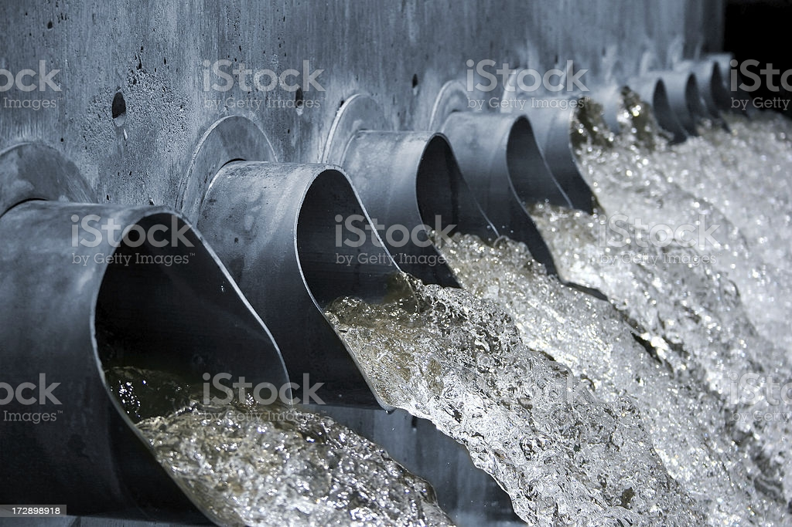
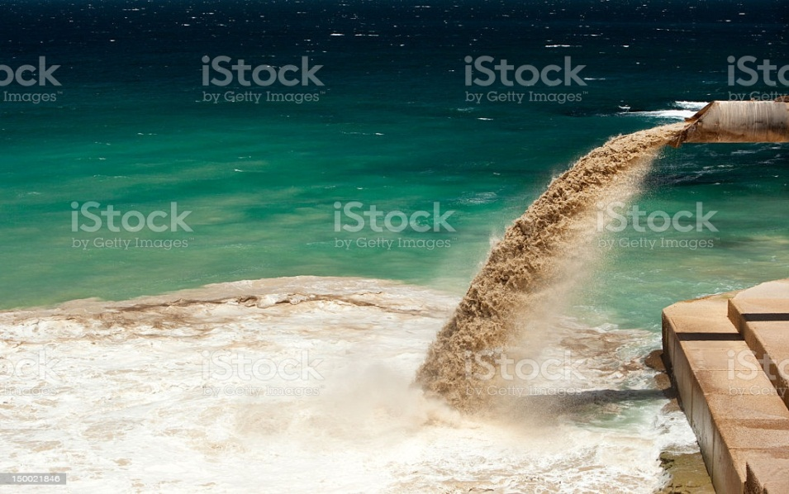
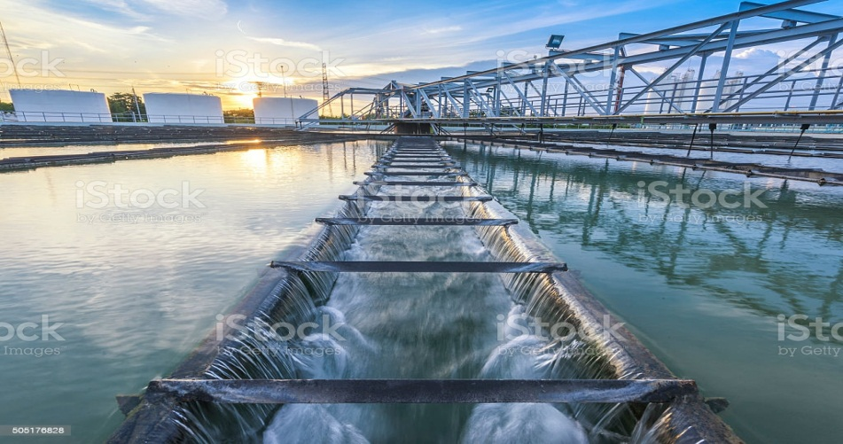
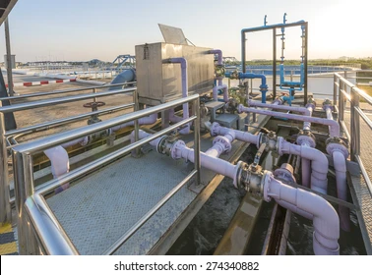
Con’t……..
Waste water released from industries
Waste water treatment

Slide 3
CON’T……..
2.1. Sources of water
Water is an essential resource for living systems, industrial processes, agricultural production and domestic use.
It is also used as recreational and environmental activities.
Virtually all of these human uses require fresh water.
97% of water on the Earth is salt water, leaving only 3% as fresh water of which slightly over two thirds is frozen in glaciers and polar caps.

Slide 4
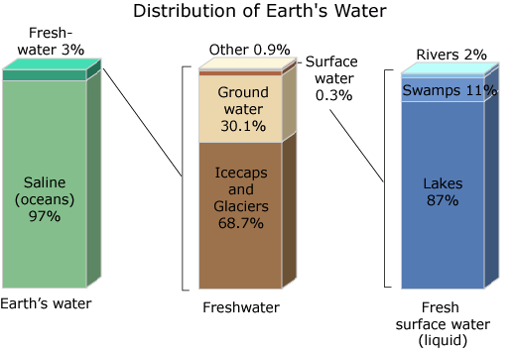
Con’t……..

Slide 5
Con’t……..
Surface water
is water in a river, lake or fresh water wetland.
Surface water is naturally replenished by precipitation and naturally lost through discharge to the oceans, evaporation, and sub-surface seepage.
Although the only natural input to any surface water system is precipitation within its watershed,
The total quantity of water in that system at any given time is also dependent on many other factors.
These factors include:

Slide 6
Con’t……..
storage capacity in lakes, wetlands and artificial reservoirs,
the permeability of the soil beneath these storage bodies,
the runoff characteristics of the land in the watershed, the timing of the precipitation and local evaporation rates.
All of these factors also affect the proportions of water lost.
Human activities can have a large and sometimes devastating impact on these factors.
ii) Ground water
Sub-surface water, or groundwater, is fresh water located in the
pore space of soil and rocks.

Slide 7
Con’t……..
Sometimes it is useful to make a distinction between sub-surface water that is closely associated with surface water and deep sub-surface water in an aquifer (sometimes called "fossil water").
Quality of Water
Water quality is the physical, chemical and biological characteristics of water.
It is most frequently used by reference to a set of standards against which compliance can be assessed.
The most common standards used to assess water quality relate to drinking water, safety of human contact and for the health of ecosystems.

Slide 8
Con’t……..
Standards for water quality
In the setting of standards, agencies make political & technical/scientific decisions about how the water will be used.
Different uses raise different concerns and therefore, different standards are considered.
Natural water bodies will vary in response to environmental. conditions.
Environmental scientists work to understand how these systems function which in turn helps to identify the sources and fates of contaminants.

Slide 9
Con’t……..
Environmental scientists work to understand how these systems function which in turn helps to identify the sources and fates of contaminants.
Categories of water quality
The parameters for water quality are determined by the intended use.
Work in the area of water quality tends to be focused on water that is treated for human consumption or in the environment.
Human consumption
Contaminants that may be in untreated water include :

Slide 10
Con’t……..
microorganisms such as viruses and bacteria;
inorganic contaminants such as salts and metals;
pesticides and herbicides;
organic chemical contaminants from industrial processes and petroleum use; and radioactive contaminants.
Water quality depends on:
the local geology and ecosystem,
as well as human uses such as sewage dispersion, industrial pollution,
use of water bodies as a heat sink,
and overuse (which may lower the level of the water).

Slide 11
Con’t……..
For people who get water from a local stream, lake, or aquifer (well), their drinking water is not filtered by the local government.
Measurement of water quality parameters
The complexity of water quality as a subject is reflected in the many types of measurements of water quality indicators.
The key basic water quality parameters that need to be addressed in an emergency are:
bacteriological indicators of fecal contamination,
Free Chlorine Residual,
pH, turbidity and possibly Conductivity/TDS.

Slide 12
Con’t……..
The following is a list of indicators often measured by situational category:
Drinking water
Alkalinity
Color of water, pH
Taste and odor
Dissolved metals and salts (sodium, chloride, potassium, calcium, manganese, magnesium)
Bacteriological analysis:
Microorganisms such as fecal coliform bacteria (Escherichia coli), Cryptosporidium, and Giardia lamblia
Dissolved organics: colored dissolved organic matter (CDOM), dissolved organic carbon (DOC)

Slide 13
Con’t……..
Physical assessment
pH
Temperature
Total suspended solids (TSS)
Turbidity
Chemical assessment
Conductivity
Dissolved Oxygen (DO)
nitrate-N
orthophosphates
Chemical oxygen demand (COD)
Biochemical oxygen demand (BOD)
Pesticides
Dissolved metals and metalloids (lead, mercury, arsenic, etc.)

Slide 14
Con’t……..
Environmental water quality;
Environmental water quality, also called ambient water quality, relates to water bodies such as lakes, rivers, and oceans.
Toxic substances and high populations of certain microorganisms can present a health hazard for non-drinking purposes such as:
irrigation,
swimming,
fishing, boating,
and industrial uses.
These conditions may also affect wildlife which use the water for drinking or as a habitat.

Slide 15
Con’t…….
Clean water is essential to our health and well-being.
Water is all around us and is ubiquitous as the air we breathe.
However despite the fact that 70 percent of the planet is covered by water, clean drinkable water is getting harder and harder to find.
Dissolved solids, suspended solids, Hardness and alkalinity in water.
Water obtained from different sources is associated with a different number of impurity.
Through out history, the quality of drinking water has been a factor in determining human welfare.
Fecal pollution of drinking water has frequently caused waterborne disease that have decimated(destroyed) the populations of whole cities.

Slide 16
Con’t…….
Unfortunately, water polluted by natural sources has caused great hardship for people forced to drink it or use it for irrigation.
Dissolved solids.
Dissolved solids" refer to any minerals, salts, metals, cations or anions dissolved in water.
Total dissolved solids (TDS) comprise:
inorganic salts (principally calcium, magnesium, potassium, sodium, bicarbonates, chlorides and sulfates) and;
some small amounts of organic matter that are dissolved in water.
TDS in drinking-water originate from:

Slide 17
Con’t…….
natural sources, sewage, urban run-off, industrial wastewater, and chemicals used in the water treatment process, and
the nature of the piping or hardware used to convey(transmit) the water, i.e., the plumbing.
Total Dissolved Solids (TDS) are:
the total amount of mobile charged ions, including minerals,
salts or metals dissolved in a given volume of water, expressed in units of mg per unit volume of water (mg/L), also referred to as parts per million (ppm).
TDS is directly related to the purity of water and the quality of water purification systems and affects everything that consumes, lives in, or uses water, whether organic or inorganic, whether for better or for worse.

Slide 18
Con’t…….
In general, the total dissolved solids concentration is the sum of the cations (positively charged) and anions (negatively charged) ions in the water.
An elevated total dissolved solids concentration does not mean that the water is a health hazard, but it does mean the water may have aesthetic problems or cause nuisance problems.
It is important to keep in mind that water with a very lower TDS concentration may be corrosive and corrosive waters may leak toxic metals such as:
copper and lead from the household plumbing

Slide 19
Con’t…….
This also means that trace metals could be present at levels that may pose a health risk.
Where do Dissolved Solids come from?
Some dissolved solids come from;
Organic sources such as leaves, silt, plankton, and industrial waste and sewage.
Other sources come from runoff from urban areas, road salts used on street during the winter, and fertilizers and pesticides used on lawns and farms.
Dissolved solids also come from inorganic materials such as rocks and air that may contain calcium bicarbonate, nitrogen, iron phosphorous, sulfur, and other minerals.

Slide 20
Con’t…….
Many of these materials form salts, which are compounds that contain both a metal and a nonmetal.
When TDS levels exceed 1000 mg/L it is generally considered unfit for human consumption.
A high level of TDS is an indicator of potential concerns, and warrants (justifies) further investigation.
How do we reduce or remove the TDS in our water?
Common water filter and water purification systems:
Carbon Filtration(CF)
Charcoal, a form of carbon with a high surface area, adsorbs (or sticks to) many compounds, including some toxic compounds.
Water is passed through activated charcoal to remove such contaminants.

Slide 21
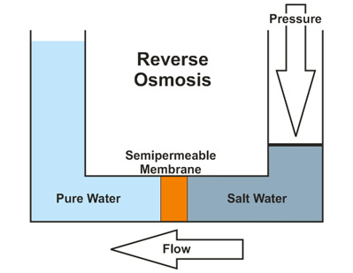
Con’t…….
Reverse Osmosis (R.O.)
Reverse osmosis works by forcing water under great pressure against a semi-permeable membrane that allows water molecules to pass through while excluding most contaminants.
RO is the most thorough method of large-scale water purification available.

Slide 22
Con’t…….
Distillation
Distillation involves boiling the water to produce water vapor.
The water vapor then rises to a cooled surface where it can condense back into a liquid and be collected.
Because the dissolved solids are not normally vaporized, they remain in the boiling solution
Deionization (DI)
Water is passed between a positive electrode and a negative electrode.
Ion selective membranes allow the positive ions to separate from the water toward the negative electrode and the negative ions toward the positive electrode.
High purity de-ionized water results.
The water is usually passed through a reverse osmosis unit first to remove

Slide 23
Con’t…….
Suspended solids:
Suspended solids refers to small solid particles which remain in suspension in water as a colloid or due to the motion of the water.
They are microscopic and make water turbid
It is used as one indicator of water quality
Hardness
Hardness is measure of polyvalent cations (ions with a charge greater than +1) in water.
Hardness generally represents the concentration of calcium (Ca²⁺ ) and magnesium (Mg²⁺) ions, because these are the most common polyvalent cations
Other ions, such as iron (Fe²⁺ ) and manganese (Mn²⁺), may also contribute to the hardness of water, but are generally present in much lower concentrations, particularly in surface waters.

Slide 24
Con’t…….
Waters with high hardness values are referred to as "hard," while those with low hardness values are "soft".
Hardness affects the amount of soap that is needed to produce foam or lather.
Hard water requires more soap, because the calcium and magnesium ions form complexes with soap, preventing the soap from forming bubble or lather.
Hardness of the water is very important in industrial uses, because it forms scale in heat exchange equipment, boilers, and pipes.
Some hardness is needed in plumbing systems to prevent corrosion of pipes.

Slide 25
Con’t…….
Hardness mitigates(to reduce) metals toxicity, because Ca²⁺ and Mg²⁺) help keep fish from absorbing metals such as lead, arsenic, and cadmium into their bloodstream through their gills.
The greater the hardness, the harder it is for toxic metals to be absorbed through the gills.
Because hardness varies greatly due to differences in geology, there are no general standards for hardness.
The hardness of water can naturally range from zero to hundreds of milligrams per liter (or parts per million).

Slide 26
Con’t…….
Waters with a total hardness:
In the range of 0 to 60 mg/L are termed soft;
From 60 to 120 mg/L moderately hard;
From 120 to 180 mg/L hard;
and above 180 mg/L very hard.
Hardness in water is defined as the presence of multivalent cations.
Hardness in water can cause water to form scales and a resistance to soap.
It can also be defined as water that doesn’t produce lather with soap solutions, but produces white precipitate (scum).
For example, sodium stearate reacts with calcium:
2C₁₇H₃₅COONa + Ca²⁺ → (C₁₇H₃₅COO)₂Ca + 2Na⁺

Slide 27
Con’t…….
Hardness of water may also be defined as:
the soap-consuming capacity of water, or
the capacity of precipitation of soap as a characteristic property of water that prevents the lathering of soap
What are the causes of Hardness?
Causes - Bicarbonates, sulfate and chloride forms salts with Mg and Ca ion
The six salts that causes hardness are:
Ca(HCO₃)₂,Mg(HCO₃)₂,CaSO₄,MgSO₄,CaCl₂ and MgCl₂.

Slide 28
Con’t…….
Types( Forms) of water hardness
Temporary hardness
b) Permanent hardness
How can we divide water hardness?
Cation | Anion | Types of Hardness | How to remove
Mg²⁺/Ca²⁺ | CO₃^{2_} or HCO₃⁻ | Temporary | Boiling or Filtration
Mg²⁺/Ca²⁺ | Anything else other than CO₃^{2_} or HCO₃⁻ | Permanent hardness | Complicated chemical treatment

Slide 29
Con’t…….
a) Temporary hardness
Also called hydrocarbonate hardness or Temporary hardness
Forms a precipitate when the water is heated to the following point.
Accordingly:-
2HCO₃⁻ →CO₃²⁻ + CO₂ + H₂O
Ca²⁺ + CO₃²⁻ → CaCO₃ ↓
Ca²⁺ 2HCO₃⁻ → CaCO₃↓ + CO₂ + H₂O
CaCO₃ forms scale

Slide 30
Con’t…….
N.B Magnesium will form a precipitate at the boiling point of water as well (MgCO₃)
Temporary hardness related to the amount of Ca²⁺ and Mg²⁺ ,which is equivalent to the bicarbonate and carbonate content
Boiling the water promotes the following reaction; by driving off the carbon dioxide gas : 2 HCO₃⁻ → CO₃^{2–} + CO₂
The CO₃^{2–} reacts with Ca²⁺ or Mg²⁺ ions, to form insoluble calcium and magnesium carbonates which precipitate out.
Temporary hardness is caused by a combination of calcium ions and bicarbonate ions in the water.

Slide 31
Con’t…….
It can be removed by boiling the water or by the addition of lime (calcium hydroxide).
Boiling promotes the formation of carbonate from the bicarbonate and precipitates calcium carbonate out of solution, leaving water that is softer upon cooling
b) Permanent hardness
Permanent hardness is hardness (mineral content) that cannot be removed by boiling.
Not form precipitate during heating
It is usually caused by the presence in the water of calcium and magnesium sulfates and/or chlorides which become more soluble as the temperature rises.

Slide 32
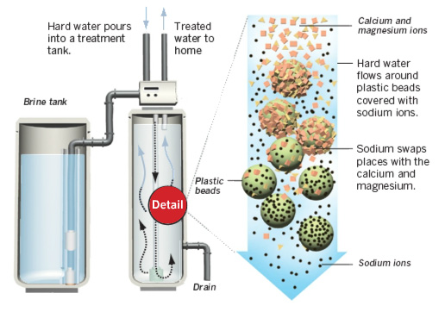
Con’t…….
Despite the name, permanent hardness can be removed using a water softener or ion exchange column, where the calcium and magnesium ions are exchanged with the sodium ions in the column.

Slide 33
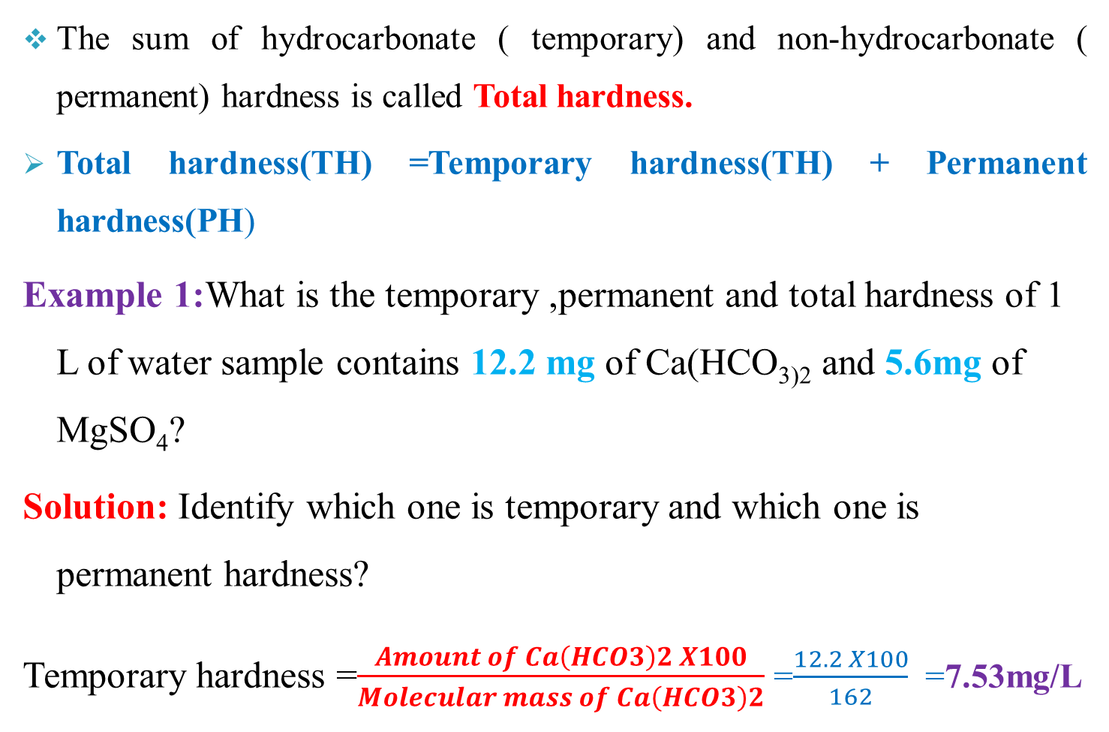
Con’t…….
The sum of hydrocarbonate ( temporary) and non-hydrocarbonate ( permanent) hardness is called Total hardness.
Total hardness(TH) =Temporary hardness(TH) + Permanent hardness(PH)
Example 1:What is the temporary ,permanent and total hardness of 1 L of water sample contains 12.2 mg of Ca(HCO₃₎₂ and 5.6mg of MgSO₄?
Solution: Identify which one is temporary and which one is permanent hardness?
Temporary hardness =$\frac{Amount of Ca\left(HCO3\right)2 X100}{Molecular mass of Ca\left(HCO3\right)2}$ =$\frac{12.2 X100}{162}$ =7.53mg/L

Slide 34
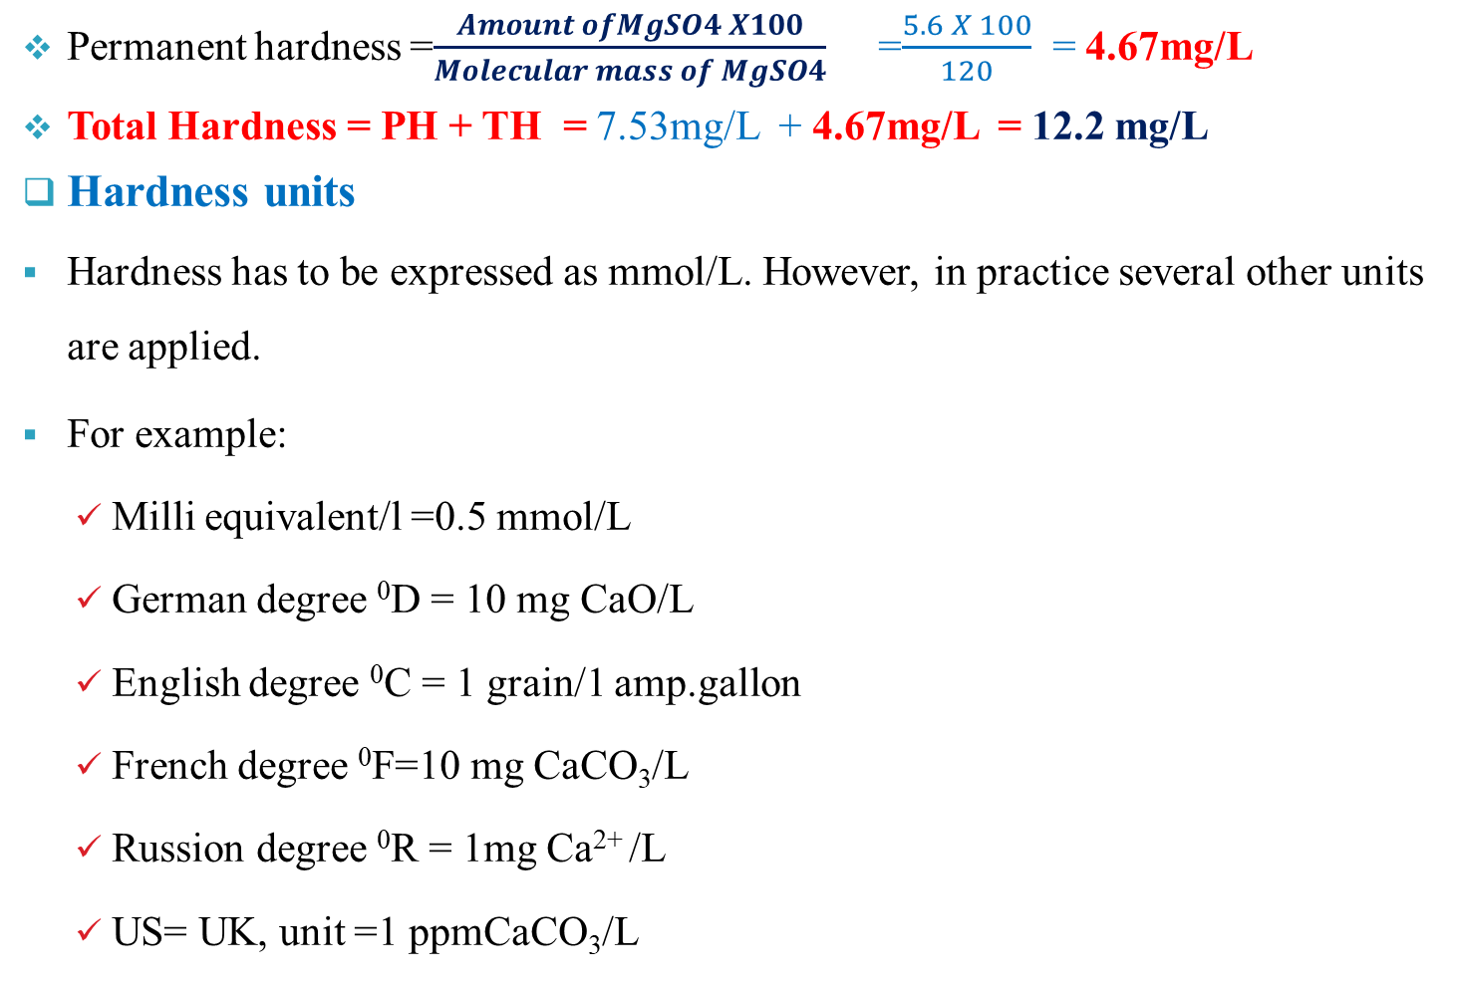
Con’t…….
Permanent hardness =$\frac{Amount ofMgSO4 X100}{Molecular mass of MgSO4}$ =$\frac{5.6 X 100}{120}$ = 4.67mg/L
Total Hardness = PH + TH = 7.53mg/L + 4.67mg/L = 12.2 mg/L
Hardness units
Hardness has to be expressed as mmol/L. However, in practice several other units are applied.
For example:
Milli equivalent/l =0.5 mmol/L
German degree ⁰D = 10 mg CaO/L
English degree ⁰C = 1 grain/1 amp.gallon
French degree ⁰F=10 mg CaCO₃/L
Russion degree ⁰R = 1mg Ca²⁺ /L
US= UK, unit =1 ppmCaCO₃/L

Slide 35
Con’t…….
Problems caused by the use of hard water
The phenomena are caused due to the formation of insoluble compounds from Ca²⁺ /Mg²⁺ and soaps.
Soap wastage or the inability to produce a lather with soap in washing, due to this there will be high soap consumption.
Soaps are sodium or potassium salts of some fatty acids.
The sodium and potassium salts of these acids are very well soluble in water.
Precipitation occurs according to the following equations
Example:- Sodium salt of palmitic acid
2C₁₅H₃₁COONa → 2C₁₅H₃₁COO⁻ + 2Na⁺,
Dissociates: 2C₁₅H₃₁COO⁻ + Ca²⁺ → (C₁₅H₃₁COO)₂Ca ↓
Precipitate in laundry

Slide 36
Con’t…….
No lather formation, because it is inactive, here Ca²⁺ plays a great role for soap consumption.
N.B Mg²⁺ will form as well
Required/Recommended Hardness
Drinking water: < 5 mmol/L (WHO)
Boiler feed water/production of steam: <0.1 mmol/L
Cleaning bottles, clothes or dish washer:< 0.1 mmol/L
Breweries: depend on the type of beer to be produced

Slide 37
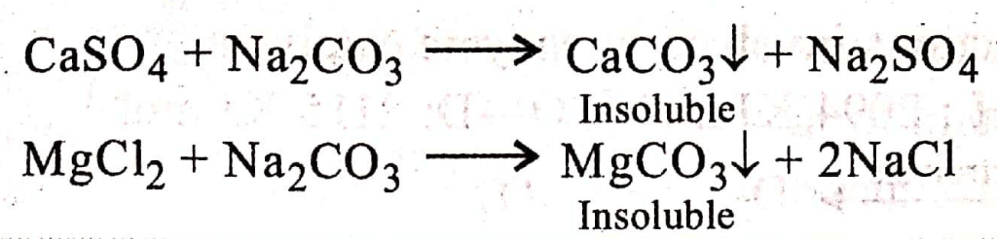
Con’t…….
Hardness removal techniques/ softening methods
Three types of principal water-softening methods are available; these are:
Chemical softening: methods based on the formation of precipitates( e.g CaCO₃)
2. Ion exchange: methods based on ion exchange

Slide 38
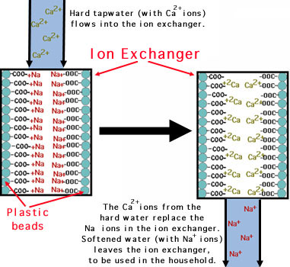
Con’t…….

Slide 39
Con’t…….
3. Desalination: Electrodialysis, Reverse Osmosis, Distillation
These techniques are too costly compared with the above two consequently it is in general not applied for water softening only

Slide 40
Con’t…….
Even though, boiling can be used to remove temporary hardness, the most economical way to soften household water is with an ion exchange water softener.
As the hard water passes through and around the beads, the hardness mineral ions are preferentially absorbed, displacing the sodium ions; this process is called ion exchange
The factors to be considered in the choice of a softening process include:
the raw-water quality,
the end use of softened water,
the cost of softening chemicals, and
the ways and costs of disposing of waste streams

Slide 41
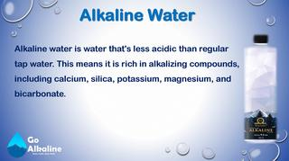
Con’t…….
Alkalinity
Alkalinity of water may be defined as its capacity to neutralize acid

Slide 42
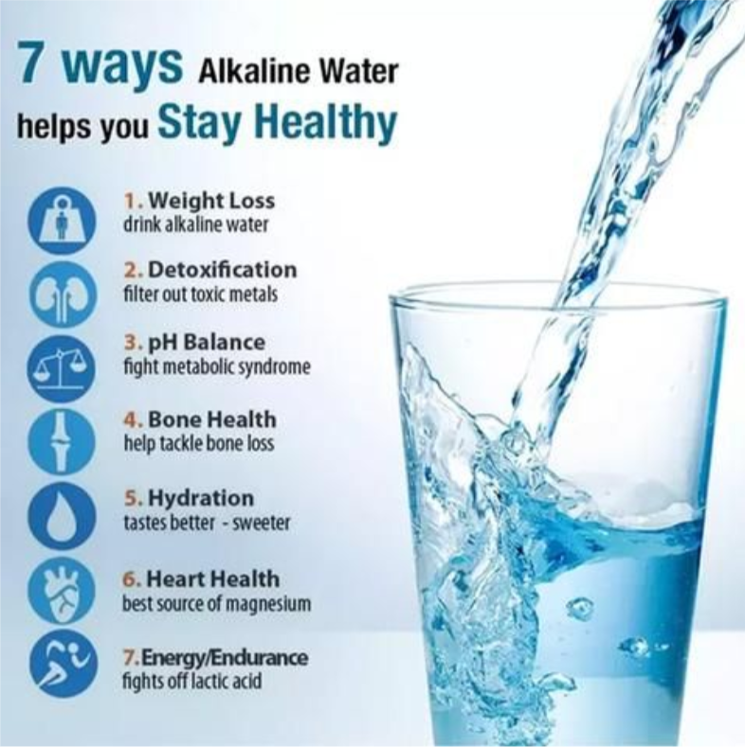
Con’t…….
Alkali substances in water include hydroxides or bases.
They can be detected by their acid-base and by the fact that they cause red litmus paper to turn blue
Excess alkalinity in an ecosystem can reduce that ecosystem’s ability to sustain life and it has the capacity of water to accept H⁺ ions
Alkalinity is important in:
water treatment
Chemistry & biology of natural waters

Slide 43
Con’t…….
Highly alkaline water is detrimental for:
Boiler
Food processing water
Municipal water systems
It is measure of water fertility
Serves as a pH buffer
Reservoir for inorganic carbon
Bicarbonate and hydroxide are responsible for alkalinity
HCO₃⁻ + H⁺ CO₂ + H₂O
CO₃²⁻ + H⁺ HCO₃⁻
OH⁻ + H⁺ H₂O
Other minor contributors NH₃ & conjugate base of phosphoric, salicylic and organic acids.

Slide 44
Con’t…….
Uses of water for industries
Industry requires pure water for many applications and utilizes a variety of purification techniques both in water supply and discharge.
Generally, Industrial water use includes water used for different purposes such as:
Fabricating, processing, washing, diluting, cooling or transporting a product
Boiler feed water

Slide 45
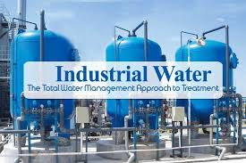
Con’t…….
Water for sprit distilleries
Water for paper mills
Water for suger factories
Water for breweries, dyeing, cooking, and laundries, and etc

Slide 46
Con’t…….
Conventional Water treatment
i) Coagulation and Filtration
What is the conventional method to treat water?
Many water treatment plants use a combination of :
coagulation,
sedimentation,
filtration and
disinfection to provide clean, safe drinking water to the public.
Worldwide, a combination of coagulation, sedimentation and filtration is the most widely applied water treatment technology, and has been used since the early 20th century.
What is coagulation?
The coagulation process involves adding iron or aluminum salts, such as aluminum sulphate, ferric sulphate, ferric chloride or polymers, to the water.

Slide 47
Con’t…….
These chemicals are called coagulants, and have a positive charge.
The positive charge of the coagulant neutralizes the negative charge of dissolved and suspended particles in the water.
When this reaction occurs, the particles bind together, or coagulate (this process is sometimes also called flocculation).
The larger particles, or floc, are heavy and quickly settle to the bottom of the water supply. This settling process is called sedimentation.

Slide 48
Con’t…….
Solids are removed by sedimentation (settling) followed by filtration.
Small particles are not removed efficiently by sedimentation because they settle too slowly; they may also pass through filters.
In coagulation, we add a chemical such as alum which produces positive charges to neutralize the negative charges on the particles.
Then the particles can stick together, forming larger particles which are more easily removed.
The coagulation process involves the addition of the chemical (e.g. alum) and then a rapid mixing to dissolve the chemical and distribute it evenly throughout the water.

Slide 49
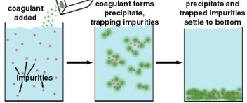
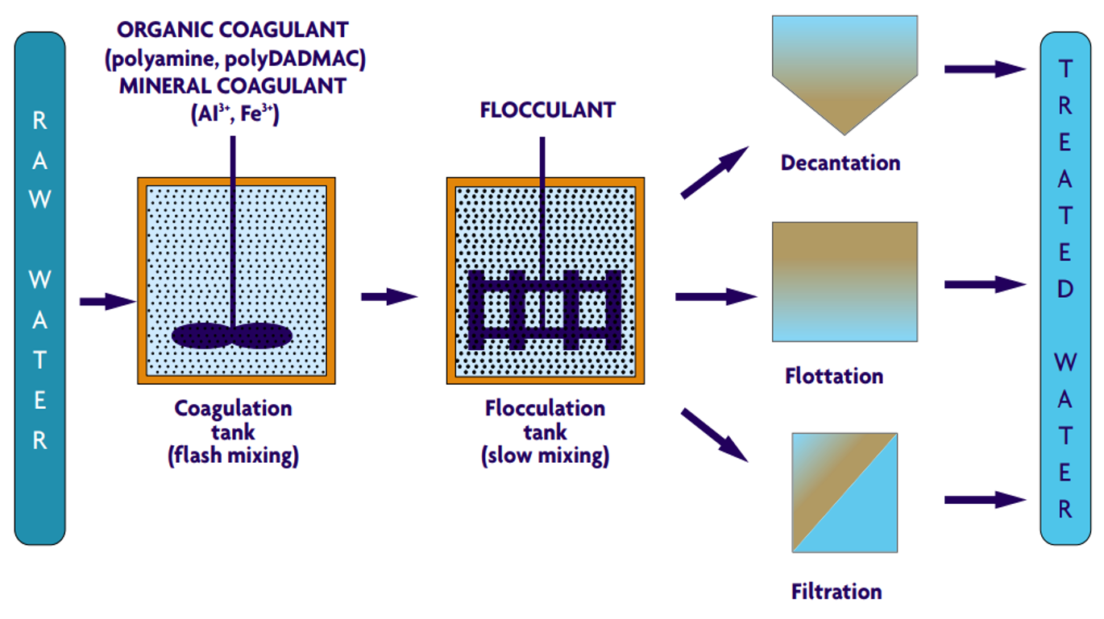
Con’t…….
Coagulation process

Slide 50
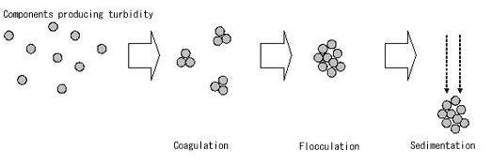
Con’t…….
The figure shows reactions and processes that occur during Coagulation, Flocculation and Sedimentation

Slide 51
Con’t…….
In a water treatment facility, the coagulant is added to the water and it is rapidly mixed, so that the coagulant is circulated throughout the water.
The coagulated water can either be filtered directly through a medium filter (such as sand and gravel), a microfiltration or ultra filtration membrane, or it can be moved to a settling tank.
In a settling tank, or clarifier, the heavy particles settle to the bottom and are removed, and the water moves on to the filtration step of the treatment process.

Slide 52
Con’t…….
What is removed during coagulation? What is added?
Coagulation can successfully remove a large amount of organic compounds, including some dissolved organic material, which is referred to as Natural Organic Matter (NOM) or Dissolved Organic Carbon (DOC).
It can also remove suspended particles, including inorganic precipitates, such as iron
A large amount of DOC can give water an unpleasant taste and odor, as well as a brown discoloration
While coagulation can remove particles and some dissolved matter, the water may still contain pathogens.

Slide 53
Con’t…….
As coagulation does not remove all of the viruses and bacteria in the water, it cannot produce safe drinking water.
It is, however, an important primary step in the water treatment process, because coagulation removes many of the particles, such as dissolved organic carbon, that make water difficult to disinfect.
Because coagulation removes some of the dissolved substances, less chlorine must be added to disinfect the water.
If ferric sulphate is used, iron and sulphate are added to the water.
If ferric chloride is used, iron and chloride are added.
And if aluminum sulphate is used, aluminum and sulphate are added.

Slide 54
Con’t…….
The majority of municipal water treatment plants use aluminum sulphate as the coagulation chemical.
Generally, water treatment facilities have the coagulation process set up so that the coagulant chemicals are removed with the floc.
However, it is widely accepted that treatment facilities that use aluminum based coagulants often have higher levels of aluminum in their treated water, but not by much.

Slide 55
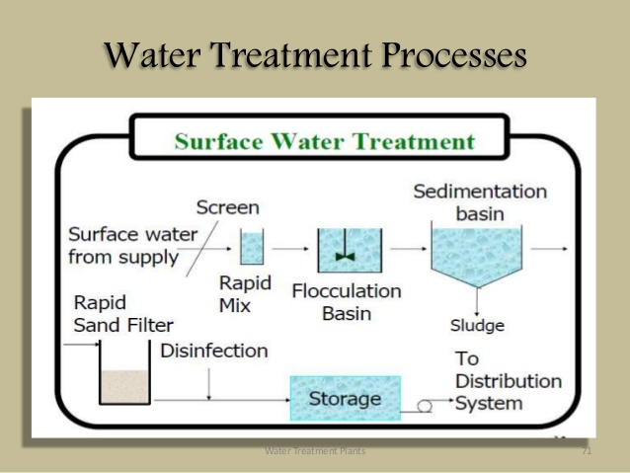
Con’t…….

Slide 56
Con’t…….
Water treatment by Filtration
What happens to water during filtration?
The second step in a conventional water treatment system is filtration, which removes particulate matter from water by forcing the water to pass through porous media.
The filtration system consists of filters with varying sizes of pores, and is often made up of sand, gravel and charcoal.
The diameter of a grain of fine sand is approximately 0.1 millimetre, so only particles with diameters less than 0.1 millimetre would pass through the fine sand layer.

Slide 57
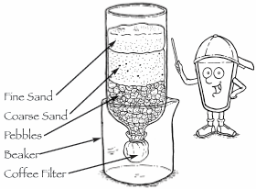
Con’t…….
This filter would not be able to produce safe drinking water, because many contaminants are much smaller than 0.1 millimetre (such as viruses, which can be as small as 0.000001 millimetre in diameter!).
Homemade filter that is made up of particles of various sizes

Slide 58
Con’t…….
There are two basic types of sand filtration; slow sand filtration and rapid sand filtration
Slow sand filtration is a biological process, because it uses bacteria to treat the water.
The bacteria establish a community on the top layer of sand and clean the water as it passes through, by digesting the contaminants in the water.
Rapid sand filtration is a physical process that removes suspended solids from the water.
Rapid sand filtration is much more common than slow sand filtration.

Slide 59
Con’t…….
Modern technology has allowed the effectiveness of slow sand filtration to be used with the rapid pace and small land area required for rapid sand filtration.
The ability of conventional treatment, such as:
sedimentation and sand filtration, is compared below with different types of membrane filtration, including
microfiltration,
ultrafiltration,
nanofiltration and
reverse osmosis.
A membrane filtration system may also be called a particle filter.

Slide 60
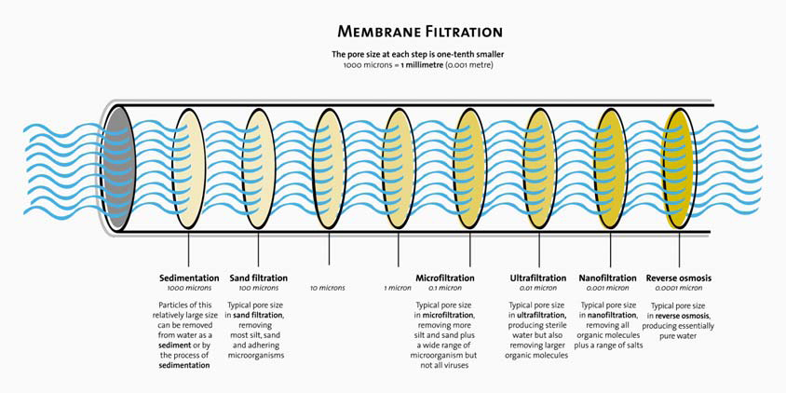
Con’t…….
The figure shows Membrane Filtration System of water

Slide 61
Con’t…….
What is removed during filtration?
The particles that are removed from the water during filtration depend upon the size of filters that are used.
Slow sand filtration removes:
bacteria,
protozoa and viruses,
and produces essentially clean water, though it is still advisable to use a disinfectant as a precautionary measure.
Rapid sand filtration removes suspended particles, but in general does not remove bacteria, protozoa, or viruses.

Slide 62
Con’t…….
In water treatment plants, filtration removes a large number of contaminants, but still requires disinfection to produce drinking water that is safe
Reverse osmosis
Is a filtration method that removes many types of large molecules and ions from solutions by applying pressure to the solution when it is on one side of a selective membrane

Slide 63
Con’t…….
Involves a diffusive mechanism so that separation efficiency is dependent on solute concentration, pressure, and water flux rate
Is most commonly known for its use in drinking water purification from seawater, removing the salt and other substances from the water molecules.
Water treatment by ion-exchange process and electro-dianalysis.
Water treatment by Ion-exchange process
The term “ion exchange” describes the process: as water flows through a bed of ion exchange material, undesirable ions are removed and replaced with less objectionable ones

Slide 64
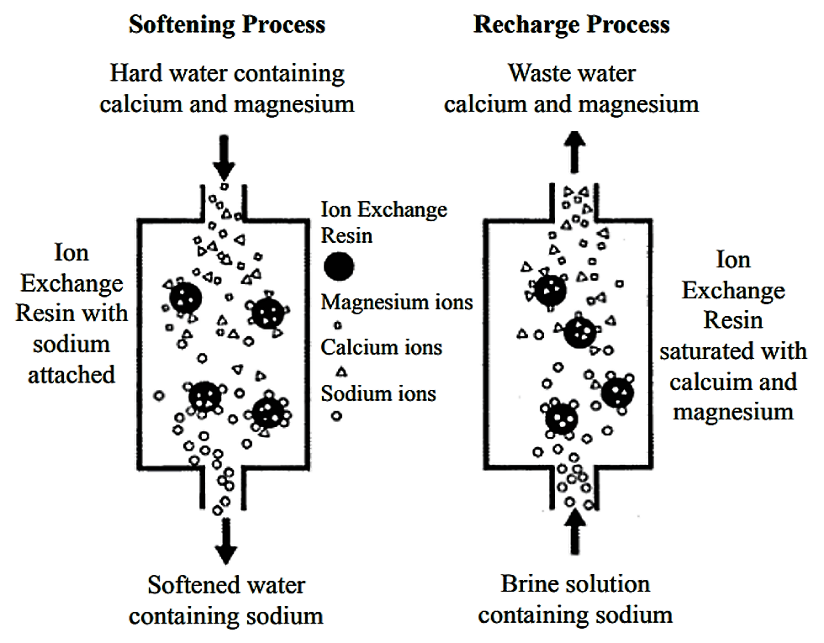
Con’t…….
For example, in softening processes calcium and magnesium ions (hardness) are exchanged for sodium ions.

Slide 65
Con’t…….
ION EXCHANGE MATERIALS
Ion exchange processes are versatile — specific types of ions can be removed from water depending on the choice of exchange material and regenerant used.
Sodium cation exchanger
As the name indicates it involves exchange of cations.
Thus, sodium cation exchanger involve exchange of sodium cation(Na⁺) with (Ca²⁺ & Mg²⁺).
Hence Calcium and magnesium are removed from water by cation exchange of sodium with calcium and magnesium.
In this case sodium chloride is softening salt

Slide 66
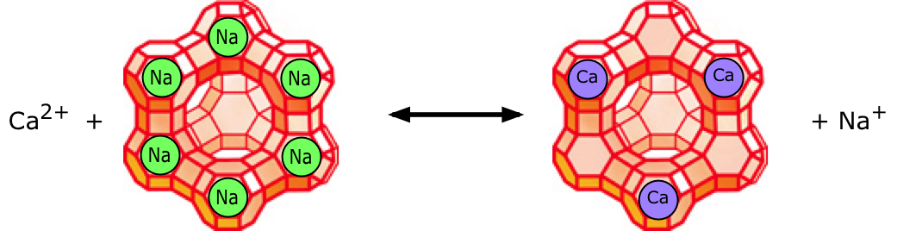
Con’t…….
Calcium or magnesium ions in the water displace sodium ions, which are released into the water.

Slide 67
Con’t…….
Electrodialysis
Electrodialysis consists of a direct current across a body of water separated into vertical layers by membranes alternatively permeable to cations and anions.
Electrodialysis involves passing water between two plates with opposite electrical charges.
Cations migrate toward the cathode and anions toward the anode.
Cations and anions both enter one layer of water, and both leave the adjacent layer.

Slide 68
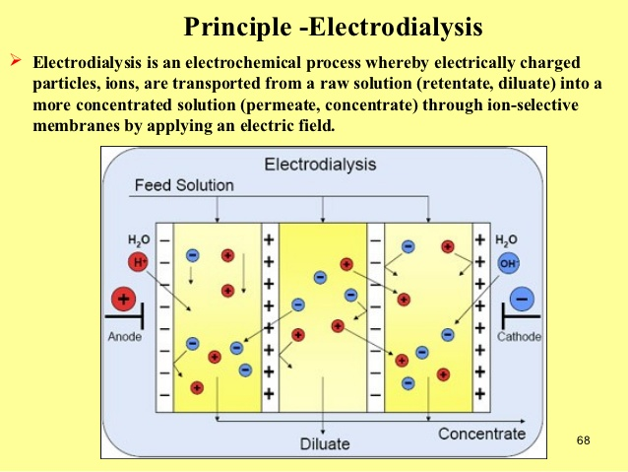
Con’t…….

Slide 69
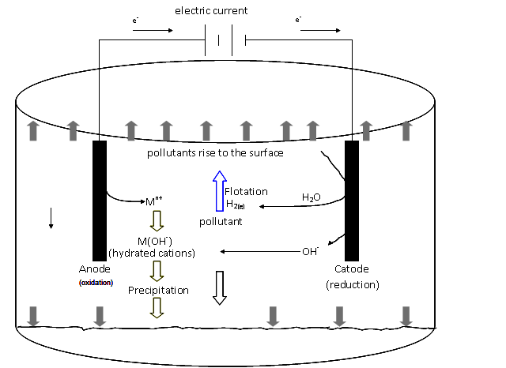
Con’t…….

Slide 70
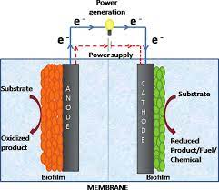
Con’t…….

Slide 71
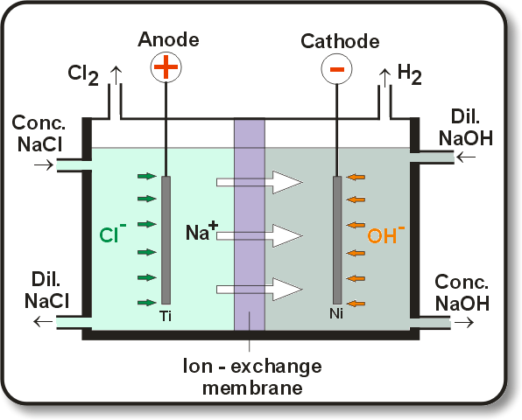
Con’t…….
Figure: Electoerdialysis(ED) apparatus for the removal of ionic material from water
ED water treatment is used with Water Quality on very hard water, with a hardness of more than 500 mg/L as calcium carbonate.

Slide 72
Con’t…….
Disinfection
Disinfection method of water treatment either destroys or inactivates the microorganism by damaging the cell wall or alliterates cell permeability.
There are two methods of Disinfection
Physical method
Includes:- Disinfection by heat (Boiling of water)
Disinfection by light( sunlight, UV-ray)
ii) Chemical method
Involve chemical interaction; these include
Using oxidizing chemical ( O₃, H₂O₂, KMnO₄)
Metal ions ( e.g; Cu⁺ is bactericidal)
Alkalis and acids

Slide 73
Con’t…….
Chlorination
It is easier for application, when we consider other method of disinfections
Some of the chemicals are coasty to use
Some are destructive
Some require additional process
Example: Destruction by acids if you treat water with acid to disinfect microorganism the water become acidic hence additional stage is required that is neutralization by base.
In chlorination chloride compound is formed when chlorine is added to water interface with certain enzymes in bacterial cell or penetration to the cell wall.
Cl₂ + H₂O →HOCl + HCl ( Hydrolysis)
HOCl ↔H⁺ + ⁻Ocl
Hypochlorite(HOCl) and hypochlorite anion penetrate to the cell wall of pathogenic microorganism and accomplish disinfection.

